Slide 1
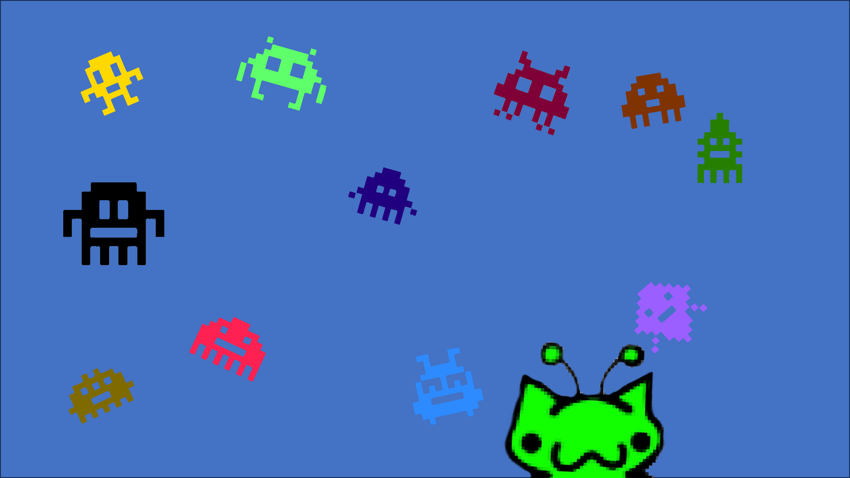
Space Invaders
A retro-style Space Invaders game where players control a spaceship to shoot down invading alien spaceships while avoiding their attacks.

Slide 2
Introduction of the Members
Radit Rifah Rahman 2524611042
Seendeed Islam 2524611042
Afrida Hossain Khan 2522096642
Course Instructor Mohammad Shifat-E-Rabbi

Slide 3
Library Functions
#include <stdio.h> - Standard Input/Output functions
#include <conio.h> - Console I/O for keyboard input (_kbhit, _getch)
#include <windows.h> - For Sleep and Beep functions
#include <stdlib.h> - For general utility functions
#include <time.h> - For time-based operations

Slide 4
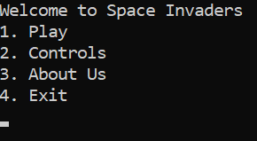
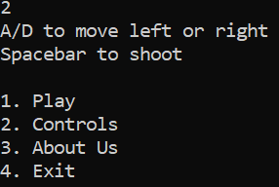
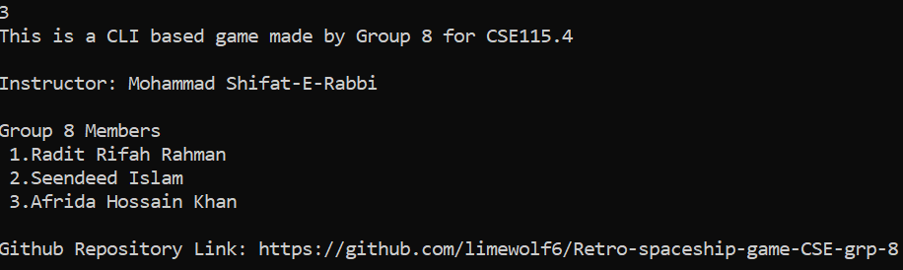
Menu Screen
Click on option 2
Click on option 3

Slide 5
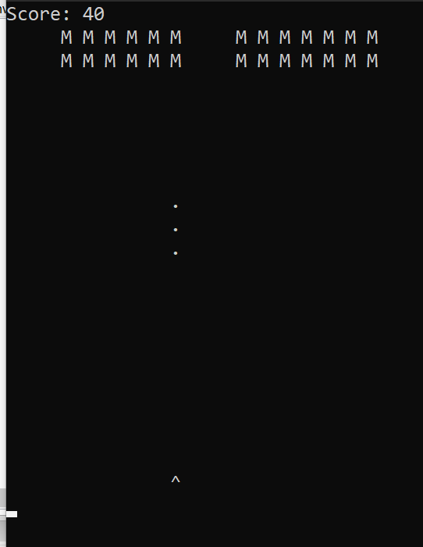

Before Update
Here
“M” represents the invaders
The “Dots” represent the bullets.
The “^” represent the player’s spaceship.
After game completion

Slide 6
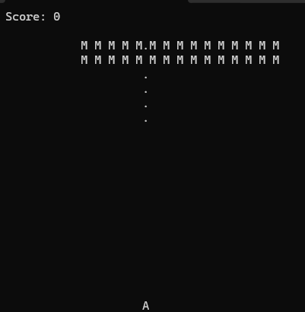
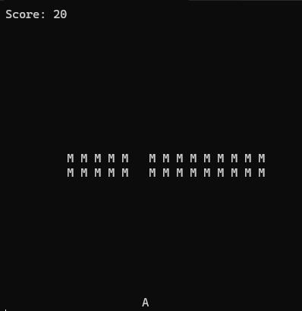
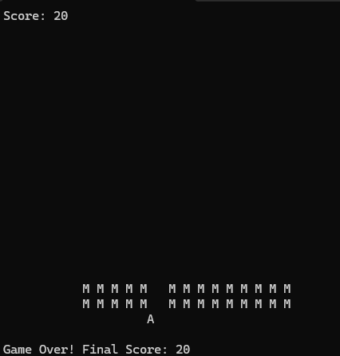
Improved Version
Initial Phase
Game ongoing
Game over

Slide 7
Improvements
The invader spaceships move now.
Ensuring the game’s good replayability.
A redesigned alien spacecraft model.

Slide 8
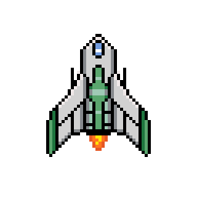
Presentation
Over !

